Slide 1

Battle of Neighborhoods
Lauryn Kopack

Slide 2
Battle of Neighborhoods
Business Problem
Clearly define a problem or an idea of your choice, where you would need to leverage the Foursquare location data to solve or execute. Remember that data science problems always target an audience and are meant to help a group of stakeholders solve a problem, so make sure that you explicitly describe your audience and why they would care about your problem.
I will be approaching this assignment from a restaurant business perspective. I'll need to use Foursquare to pull existing data on food establishments around the city of Bronx, New York and identify what variety of establishments there are in certain neighborhoods.

Slide 3
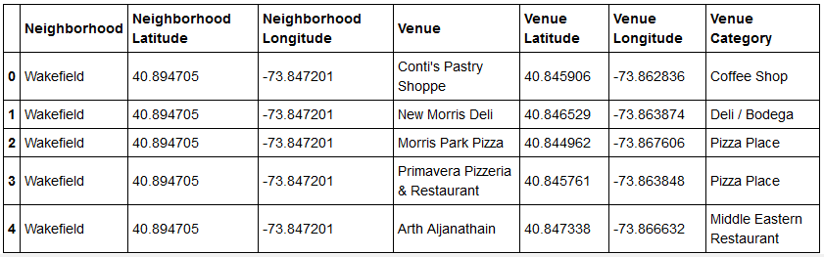
Data Used
The initial data pull provided the following venues in the Wakefield neighborhood, Bronx, New York.

Slide 4
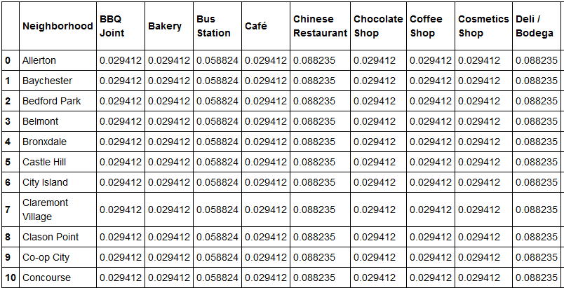
Data Used
Additional data provided the following percentiles of food establishment varieties in a variety of neighborhoods in Bronx, New York.

Slide 5
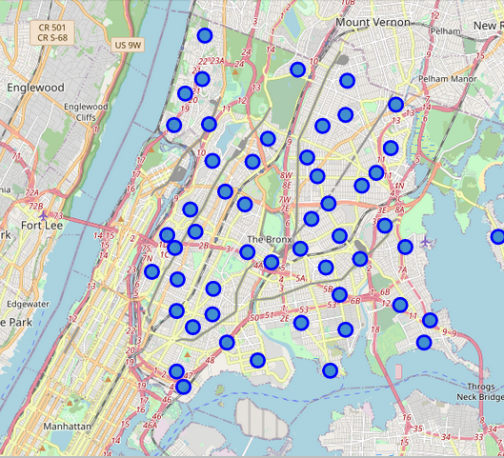
Data Visualization
The initial data pull provided the locations of different neighborhoods in The Bronx, New York .

Slide 6
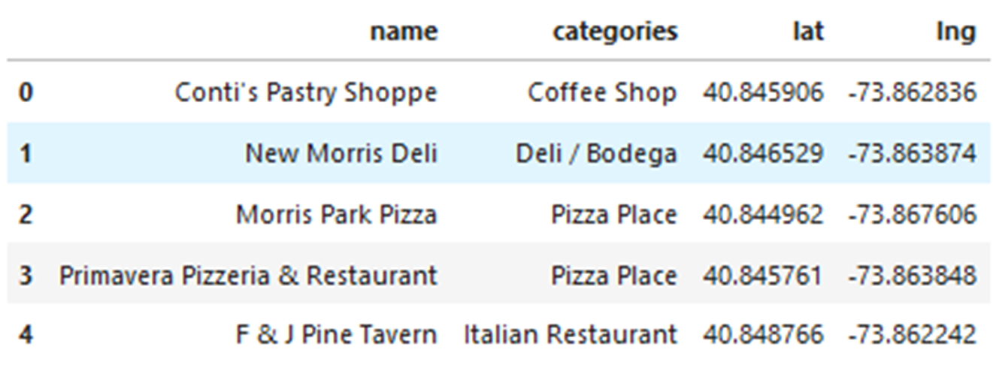
Data Collected
The data pull from Foursquare provided the following information detailing the locations of five restaurants in The Bronx, New York with corresponding latitude and longitudes for further analysis.

Slide 7
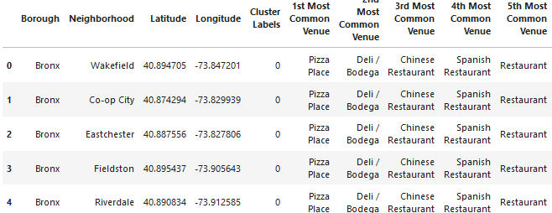
Data Obtained
After running the processes so cluster neighborhoods and pull venues from Foursquare, the scripting was able to produce the top five most common venues.

Slide 8
Results
Results/Discussion:
The top three results that were provided for the city of Bronx, NY, were pizza place, delis, and Chinese restaurants. Outcome is dependent of the type of business venture, whether it be opening a competitive food establishment to compete in the top three results or to establish a new food establishment that may not have a strong presence in the borough or neighborhood sought out to open in.

Slide 9
Conclusion
Conclusion:
In conclusion, any sort of business venture comes with risks, in the mind set of deciding an area to open an establishment, whether it be new, existing and opening more locations, or a competing variety in an area with a dense culture of fewer varieties, it is good to look at the overall demographics of the area. These methods are developed and used in order to process a lot of information in a smaller amount of time than it would take to read all the documents. And having the ability to call out to data providing websites to provide locations and types of venues, but also have the ability to collect trending data as well, can help lower some of the risk of deciding to open in certain neighborhoods by providing a lot of information at once.

